Slide 1
IMDB Sentiment Classifier Project
CSC 4850
Jason Yu

Slide 2
What is a Sentiment Classifier
A type of Natural Language Processing task
Involves identifying and classifying the tone and opinion expressed in text

Slide 3
Project Overview
Goal:
To be able to classify IMDB reviews as positive or negative
Determine which algorithm provides the best results and is the best option for this task
Approach: to use Term Frequency-Inverse Document Frequency (TF-IDF) to vectorize the dataset and then train different models with the dataset to see which work best

Slide 4
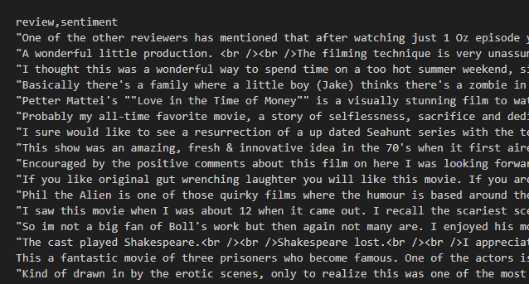
Dataset
Kaggle has a dataset of 50,000 IMDB reviews
These reviews are balanced between 25k positive and 25k negative reviews

Slide 5

Text Preprocessing
Problems with the text:
Contains HTML line breaks
Contains capital letters and punctuation
“Great”, “great”, and “great!”
Reviews may contain words that won’t be useful to the final sentiment analysis
Remove these words using NLTK’s stopword list
“the”, “it”, “was”
Ensures that word frequency is accurate

Slide 6
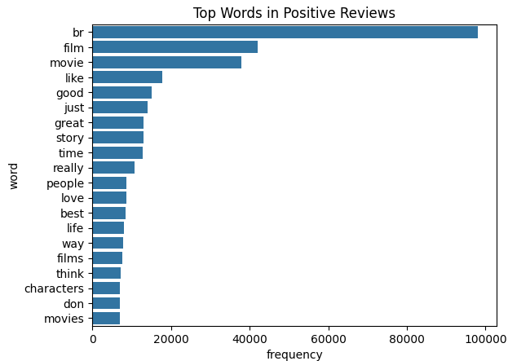
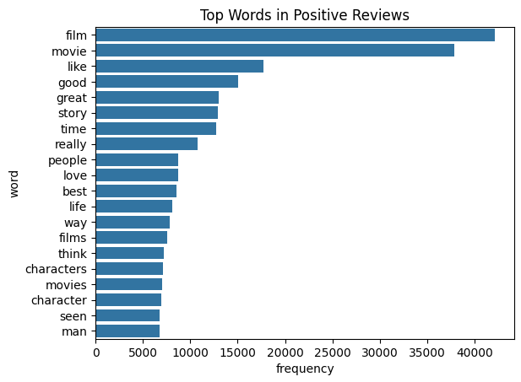
Exploratory Data Analysis (EDA)

Slide 7
Term Frequency-Inverse Document Frequency
Commonly used in NLP to evaluate the importance of a word
Term Frequency measures the amount a word appears in a document compared to the total number of words
Inverse Document Frequency reduces the weight of common words and increases those of rare words. This is because the chances a word appears less usually means that it’s more meaningful

Slide 8
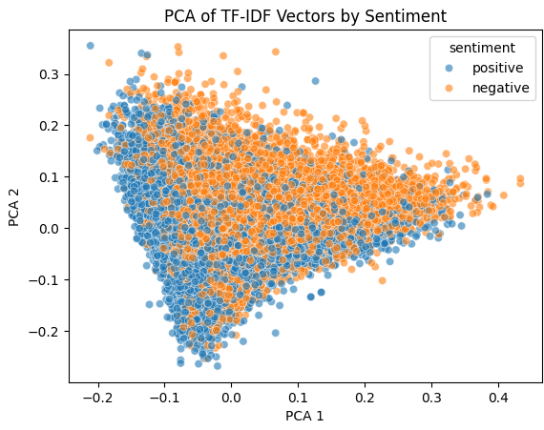
Using Principal Component Analysis for EDA
Because a TF-IDF can have thousands of features (one for each word)
Reviews that are close together use similar words and patterns

Slide 9
Evaluation Metrics
Precision: Out of all the predictions, how many were correct
Recall: Out of all the examples, how many did the model correctly identify
F1-Score: Comparison of both Precision and Recall together
Support: number of samples of each class in the test set
Precision vs Recall
Of all the emails marked as spam, how many were actually spam
Out of all the actual spam emails, how many did the it catch
Accuracy: Total Correct Predictions

Slide 10
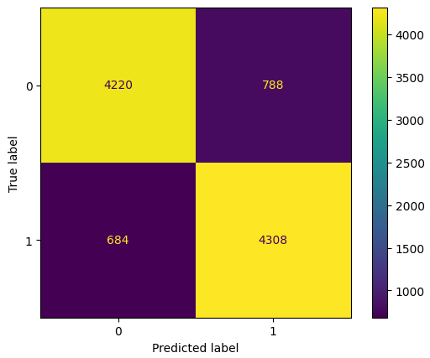
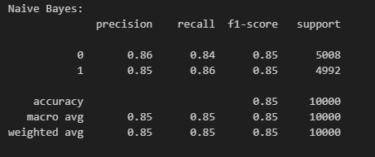
Naive Bayes
Assumes the features (words are independent)
Calculates the probability based on word frequency
Commonly used with text classification

Slide 11
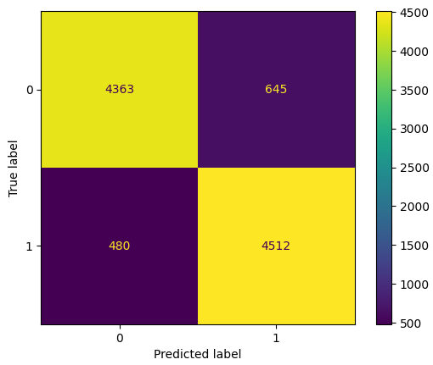
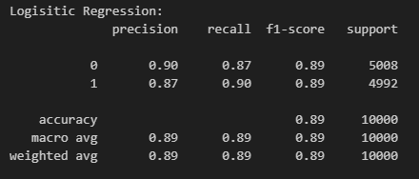
Logistic Regression
Predicts the probability using a sigmoid function
Learns weights for each word

Slide 12
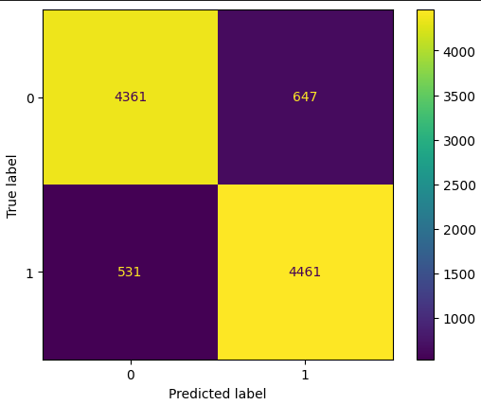
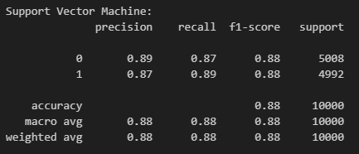
Linear Support Vector Machine
Finds an optimal hyperplane that separates the classes
Good for high-dimensional data

Slide 13
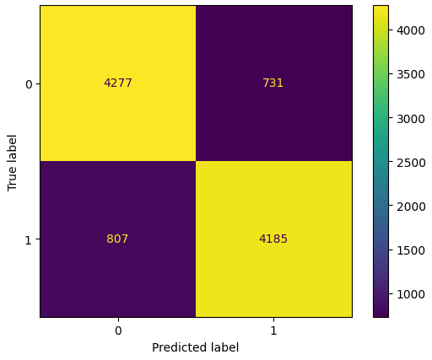
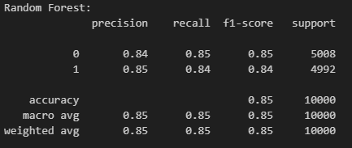
Random Forest
A bunch of decision trees that are each trained on a random subset of data
Not good with text

Slide 14
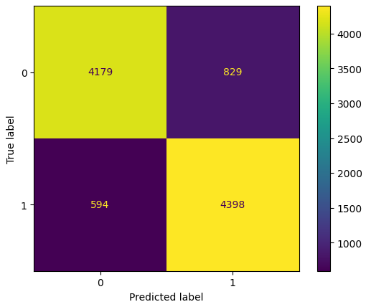
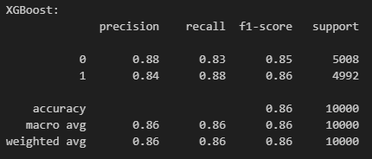
XGBoost
A boosting model that uses previous models to fix its mistakes
Limited with text jobs

Slide 15
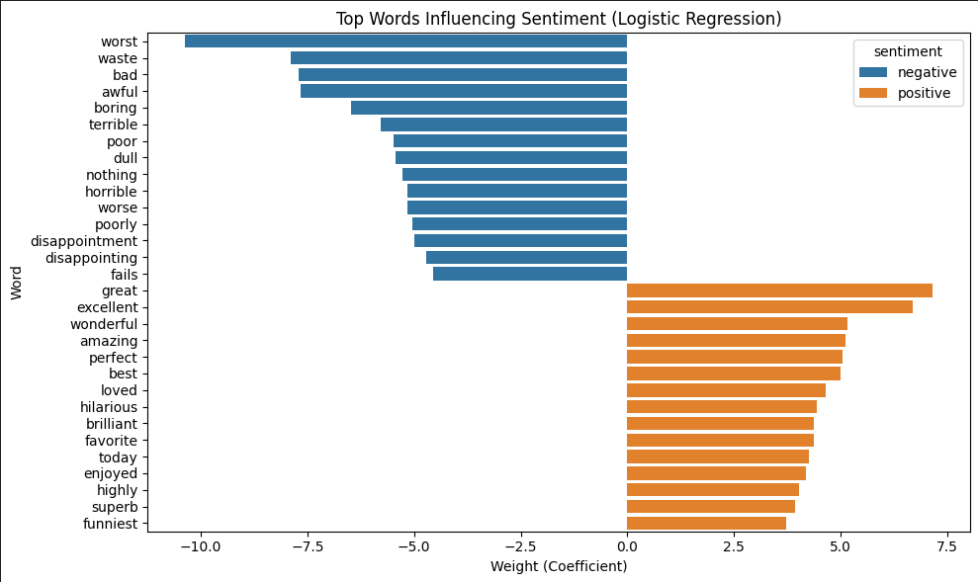
Logistic Regression Weights

Slide 16
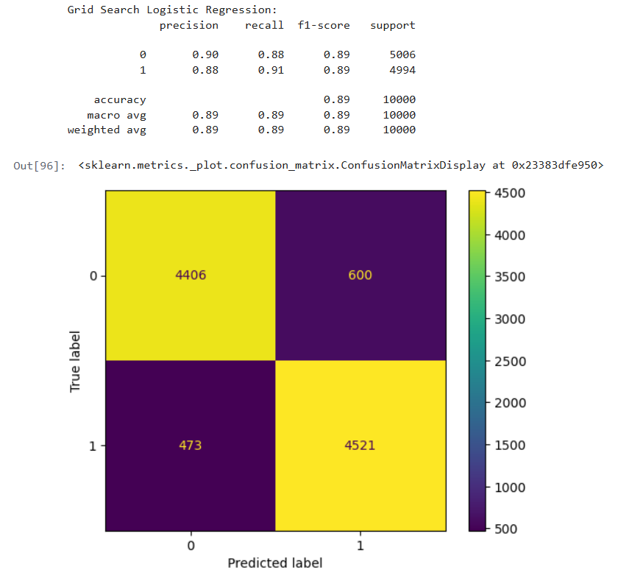
Optimizing the Models
Used a Grid Search to try different parameters of C
paramters_lr = {'C': [0.01, 0.1, 1, 10, 100]}
Accuracy stays the same at .89

Slide 17

Problems with the Model
NLTK’s stopwords might remove some vital words such as “not”
“The movie is not great” → “movie great”
Improper word tokens based on tense
“Hated” vs “hate”
Optimizing the model adjusting the text preprocessor

Slide 18
Web Demo
https://tinyurl.com/imdbsentiment
https://github.com/jasonyu17/IMDB-Sentiment-Classifier/tree/main

Slide 19
Questions
Non linear
Shallow neural network

